Slide 1

Money Withdrawal Management
Presenter Name

Slide 2
Agenda
Introduction
Key Features
User Authentication Module
Withdrawal Module
Summary
Flow diagram
Presentation Title

Slide 3

Introduction
In today's digital era, ensuring secure and efficient financial transactions is of paramount importance. Our project addresses this need by integrating a robust user login system with withdrawal functionality.
In this presentation, we will delve into the key features and functionalities of our Money Withdrawal System, highlighting the importance of user authentication and transaction security. Through our project, we aim to provide users with a seamless and reliable platform for managing their financial transactions.

Slide 4
1. Secure User Authentication: Robust login system with username and password validation. Three-strike password protection to prevent unauthorized access. 2. Efficient Withdrawal Process: Seamless withdrawal functionality for users. Balance verification before processing withdrawals. Password re-verification for added security.
Key
features
KEY
FEATURES

Slide 5
User Authentication Module
Enter Username and Password:
Username Validation:
Password Validation:
Security Measures:
Successful Login:
Users input their unique username and corresponding password.
Username serves as the account identifier, while the password acts as the authentication credential.
System verifies username authenticity against the registered user database.
Incorrect or non-existent usernames prompt users to re-enter until valid.
Upon entering a valid username, users input their password.
Password is validated against the corresponding username in the database.
System imposes a limit of three incorrect password attempts.
After three consecutive incorrect attempts, the account is temporarily blocked.
Upon successful validation of both username and password, users gain access to account functionalities.
Functionalities include initiating withdrawal transactions.

Slide 6
Withdrawal Module
Initiate Withdrawal:
Balance Verification:
Password Confirmation:
Transaction Processing:
Confirmation and Completion:
Users access the withdrawal module after successful login.
Prompted to enter the desired withdrawal amount.
System verifies if the user's account balance covers the requested withdrawal amount.
Ensures sufficient funds are available for the withdrawal.
For added security, users are prompted to re-enter their password before confirming the withdrawal transaction.
Password validation ensures authorized access to initiate withdrawals.
Upon successful balance verification and password confirmation, the withdrawal transaction is processed.
System deducts the withdrawal amount from the user's account balance.
Confirmation message indicates successful withdrawal completion.
Users receive notification of the updated account balance post-withdrawal.

Slide 7
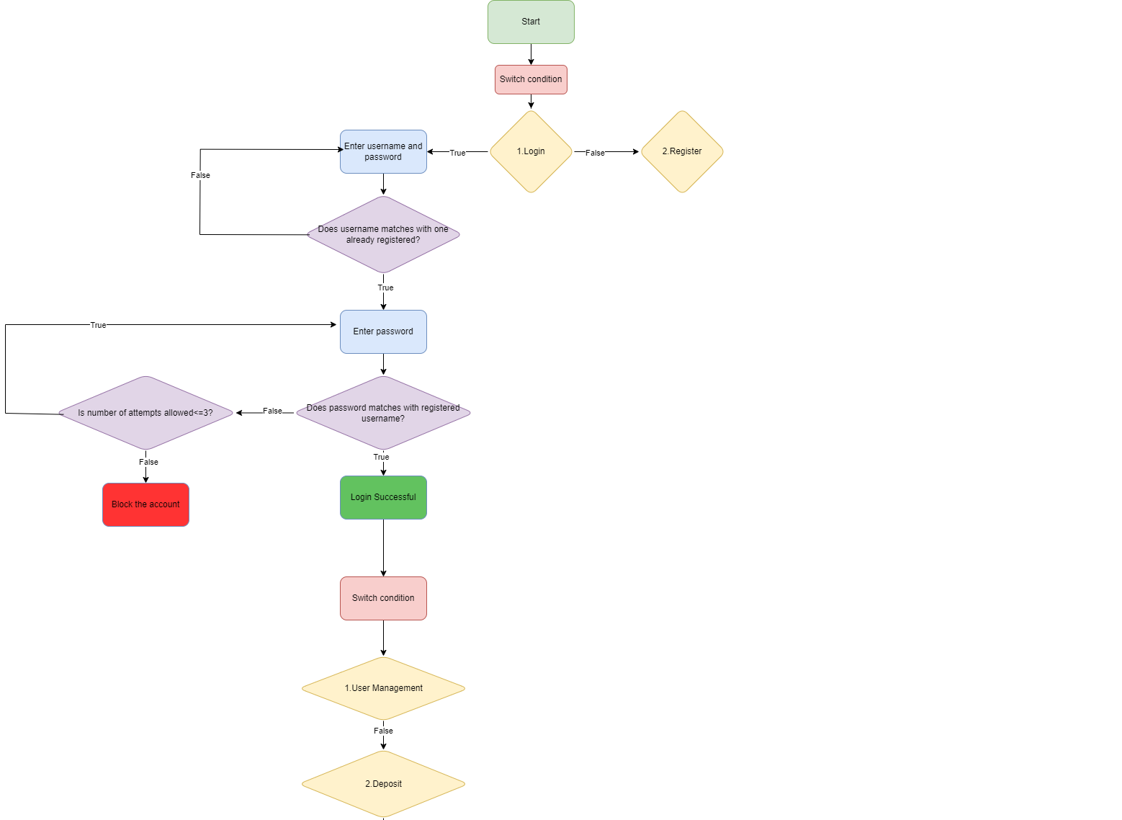
FLOW
DIAGRAM

Slide 8
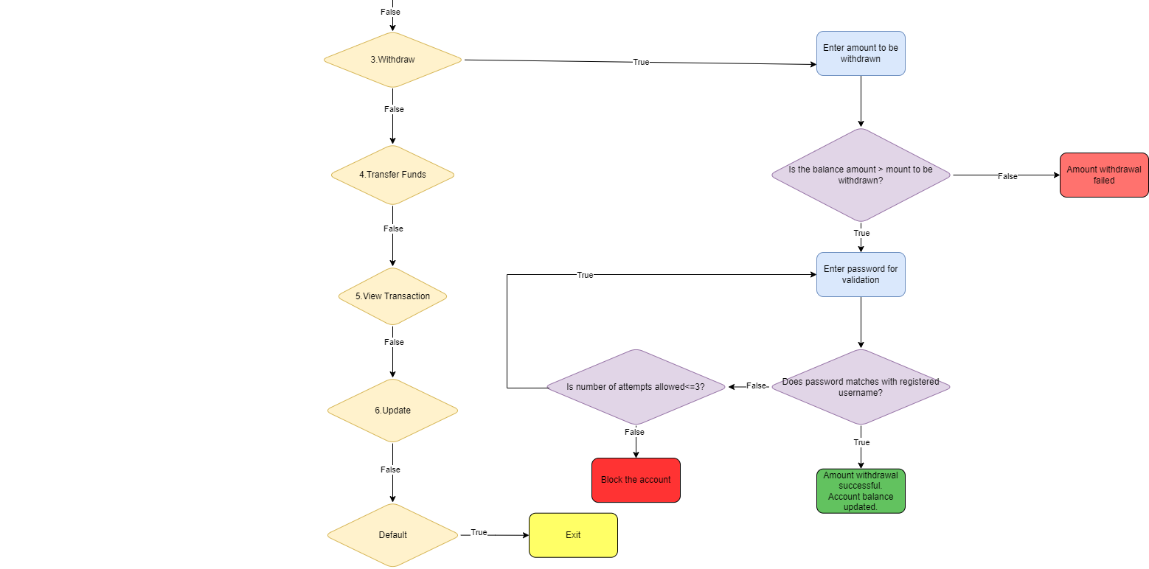

Slide 9


Summary
Our project focuses on ensuring secure and efficient financial transactions. With a user-friendly interface and robust authentication, we prioritize ease of use and account security. Through streamlined withdrawal processes and enhanced security measures, we strive to provide a reliable solution for managing financial transactions with confidence.
This Photo by Unknown Author is licensed under CC BY-SA-NC

Slide 10

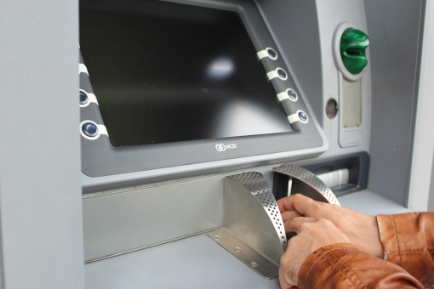
Thank you
This Photo by Unknown Author is licensed under CC BY-SA-NC

